Slide 1
Christmas Game Night

Slide 2
Welcome to Christmas game night!
Divide into 2 teams.
We will play 11 games.
You will earn points based on your brilliant Christmas knowledge, your quick wit and physical endurance, and your ability to maintain elfish Christmas cheer in the face of utter destruction. Best of luck to you.
Whichever team earns the most points wins.
Games, commence!

Slide 3
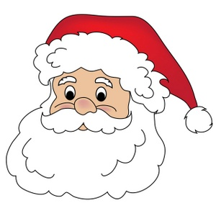

Game 1: Christmas Categories
Rotate players.
1 minute turns.
25 categories = 1 point each.

Slide 4
Ghosts who visit Scrooge

Slide 5
Types of winter clothing

Slide 6
Things you hang up at Christmas time

Slide 7
Christmas foods

Slide 8
Things you’d find in Santa’s workshop

Slide 9
Ways to say “merry Christmas”

Slide 10
Christmas or Winter animals

Slide 11
Live-action Christmas movies

Slide 12
People from the nativity

Slide 13
Ways to Wrap a Gift

Slide 14
Things you put on a gingerbread house

Slide 15
Christmas things that are red

Slide 16
Parts of the
“12 days of Christmas” song

Slide 17
songs about snow or cold weather

Slide 18
Kinds of Christmas candy

Slide 19
Things you tell Santa Claus

Slide 20
Animated Christmas movies

Slide 21
Things you put on a Christmas tree

Slide 22
Christmas things that are green

Slide 23
Things
Santa Claus tells you

Slide 24
Kinds of Christmas decorations

Slide 25
songs about Santa Claus

Slide 26
Names of Santa’s reindeer

Slide 27
Winter sports

Slide 28
Christmas hymns

Slide 30

Game 2: Snowball Blowout
No touching any snowball with any part of your body.
Timer: 2 minutes.
2 points per successful snowball.

Slide 32

Game 3: Roll A Snowman
Teams, collect a paper, pencil, and dice.
Timer: 30 seconds.
First team to complete their snowman = 3 points…
Or .25 points per completed snowman item.

Slide 33
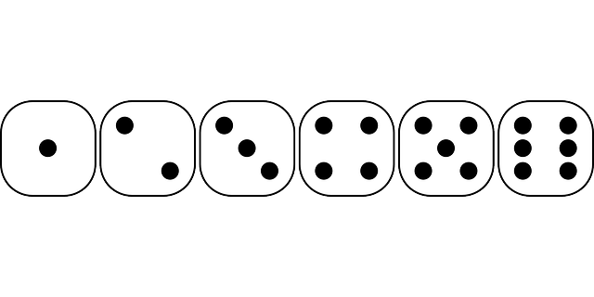
Roll:
Draw a hat
Draw a head
Draw a middle body
Draw a bottom body
Draw a face
Draw stick arms

Slide 35

Game 4: Candy Clues
Teams will offer 1 player, who gets 1 guess, per round. Wrong answers will pass the play to the other team for a steal.
4 points per correct answer.

Slide 36
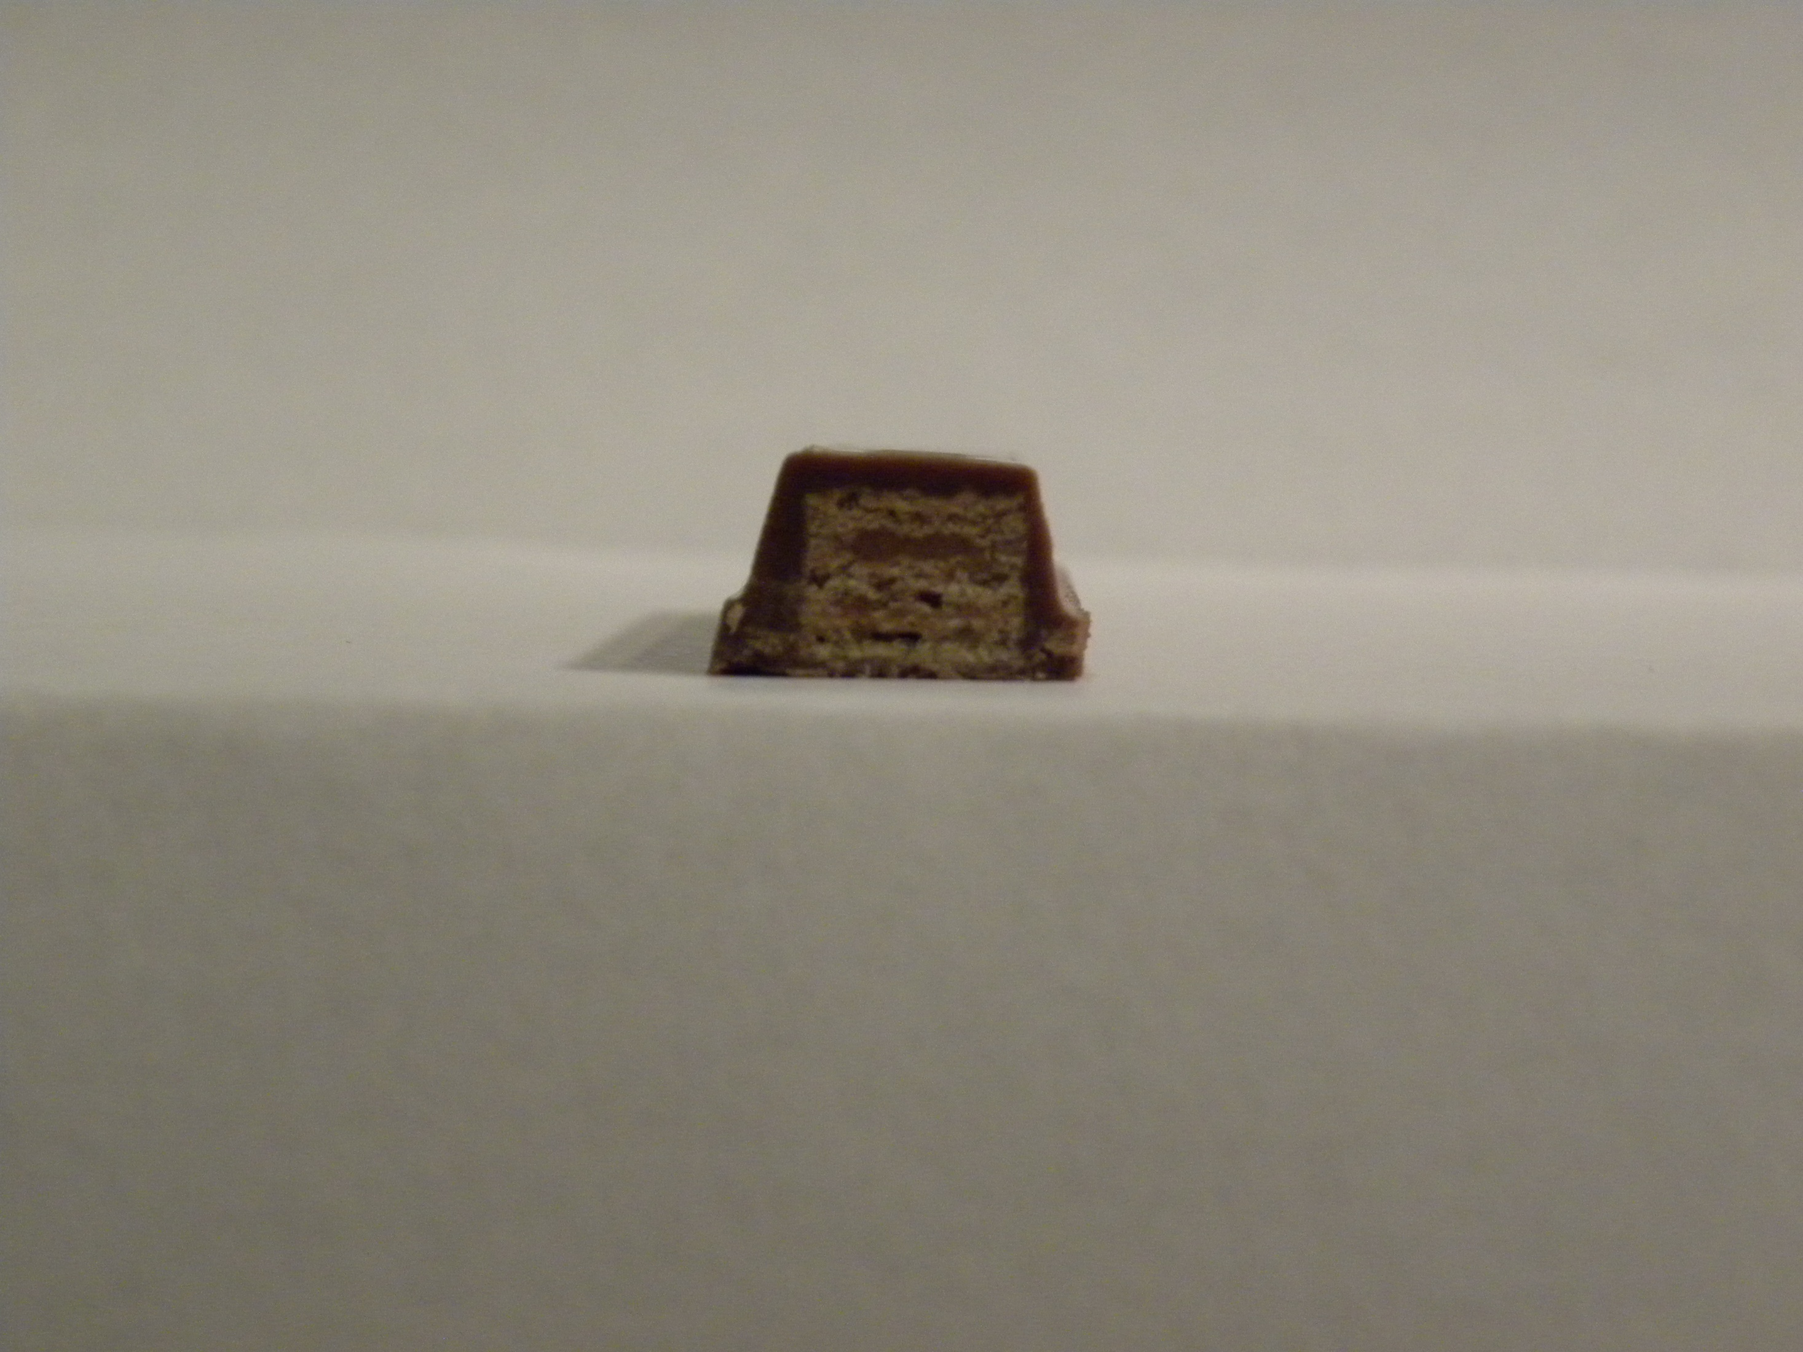
Kitkat

Slide 37
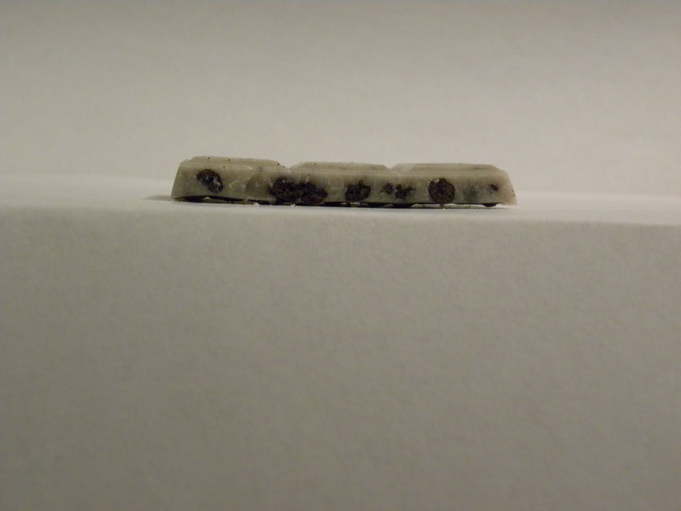
Hershey’s Cookies and Cream

Slide 38
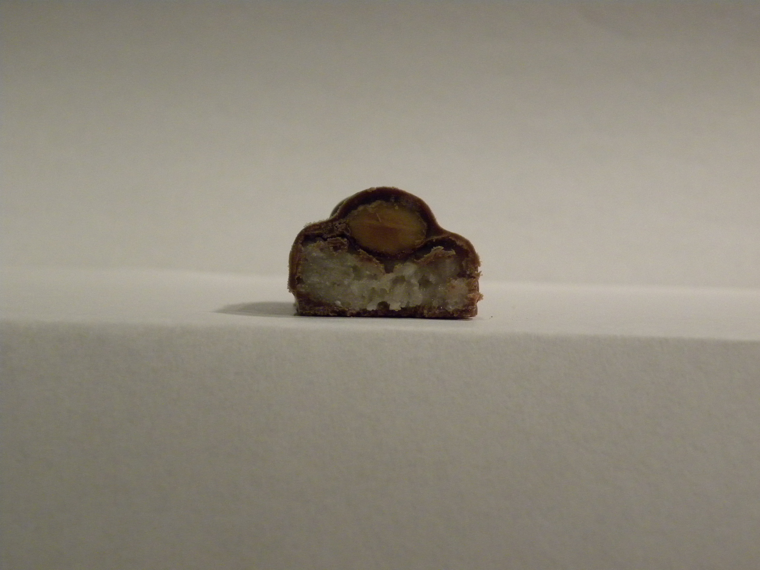
Almond Joy

Slide 39
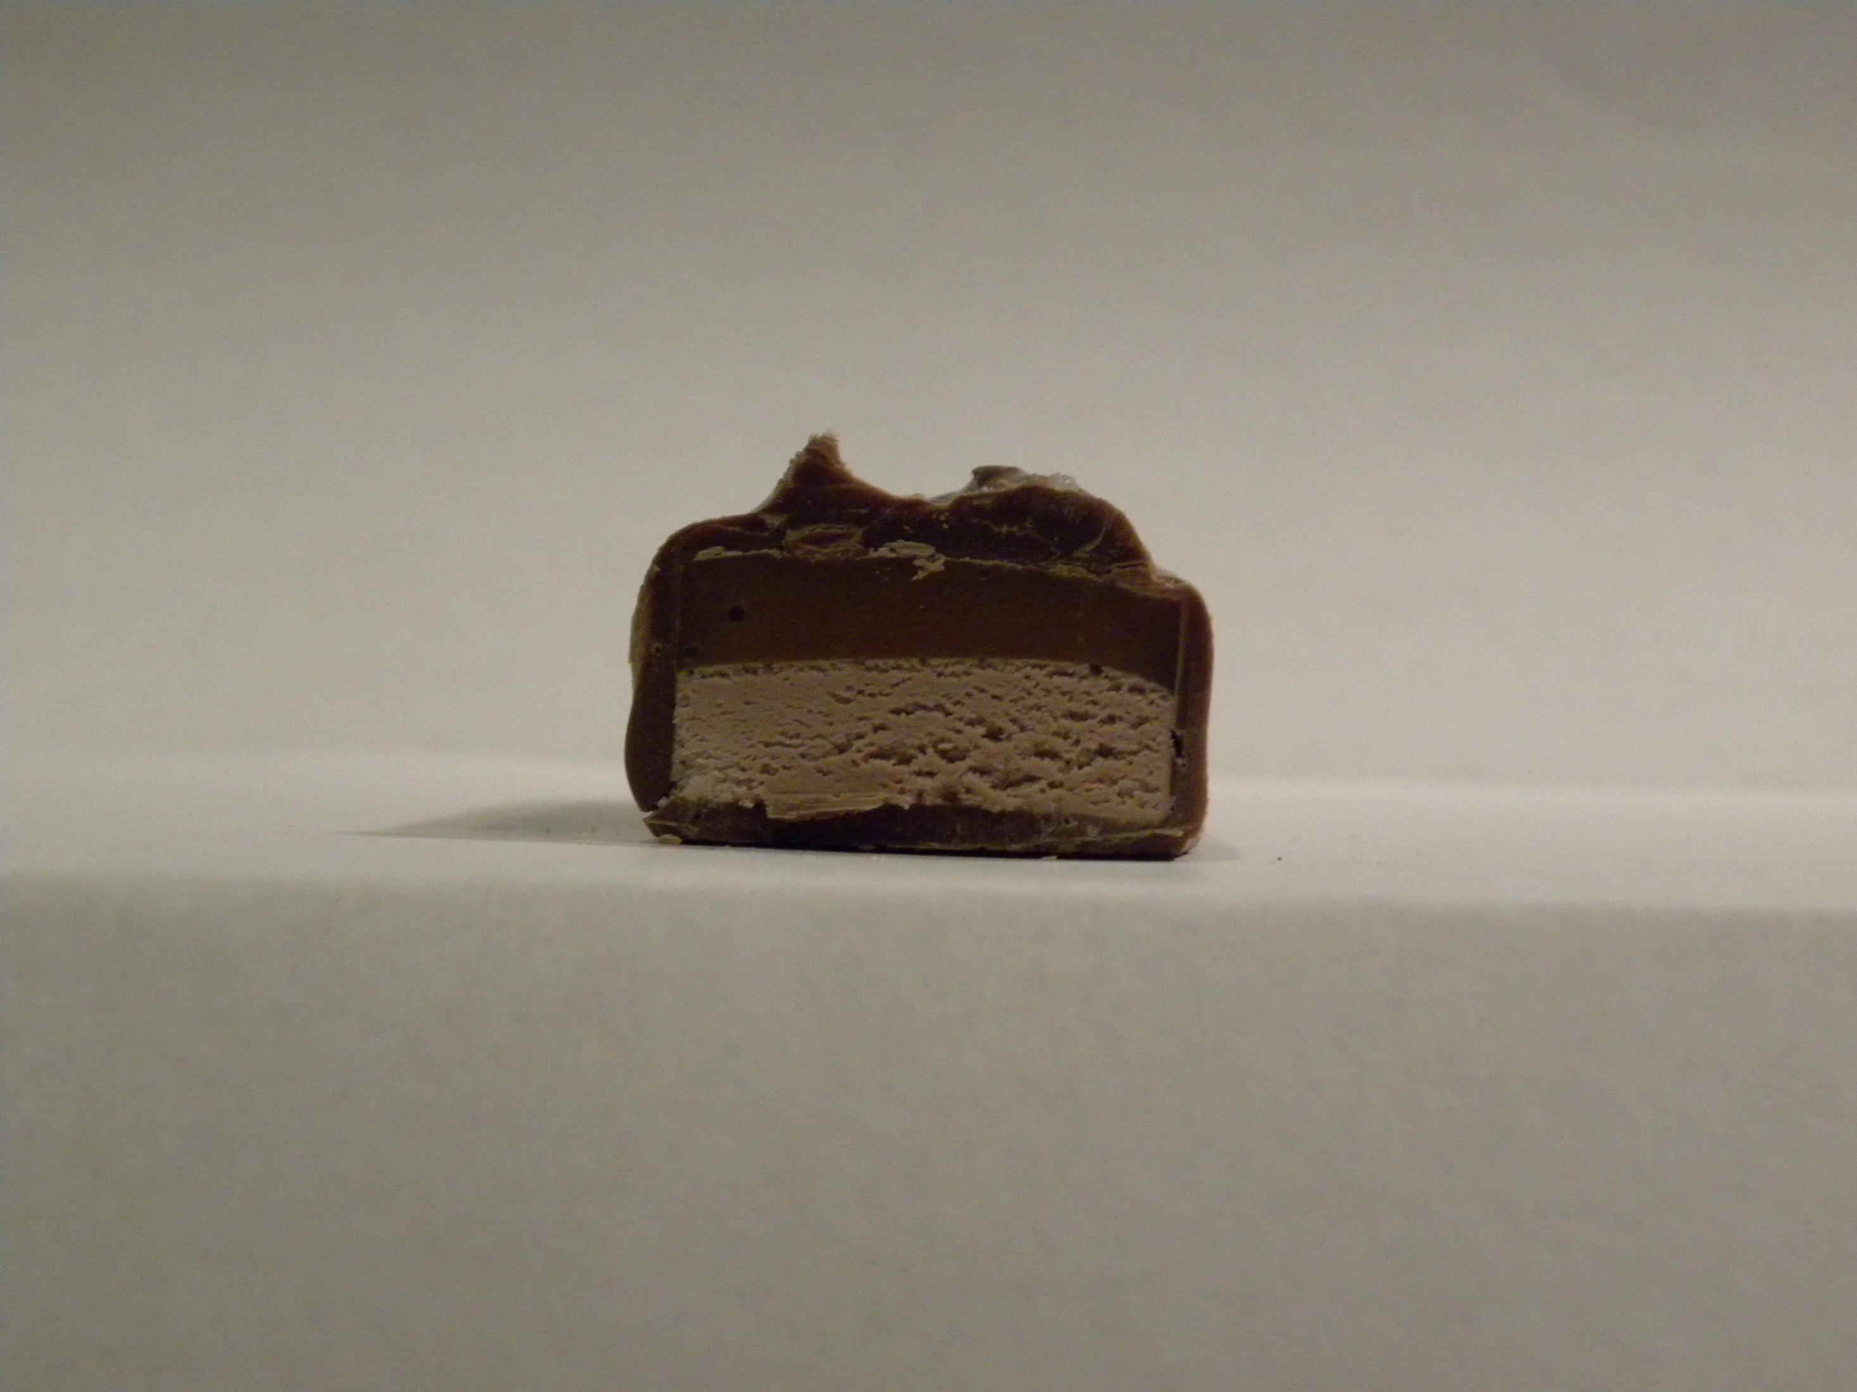
Milky Way

Slide 40
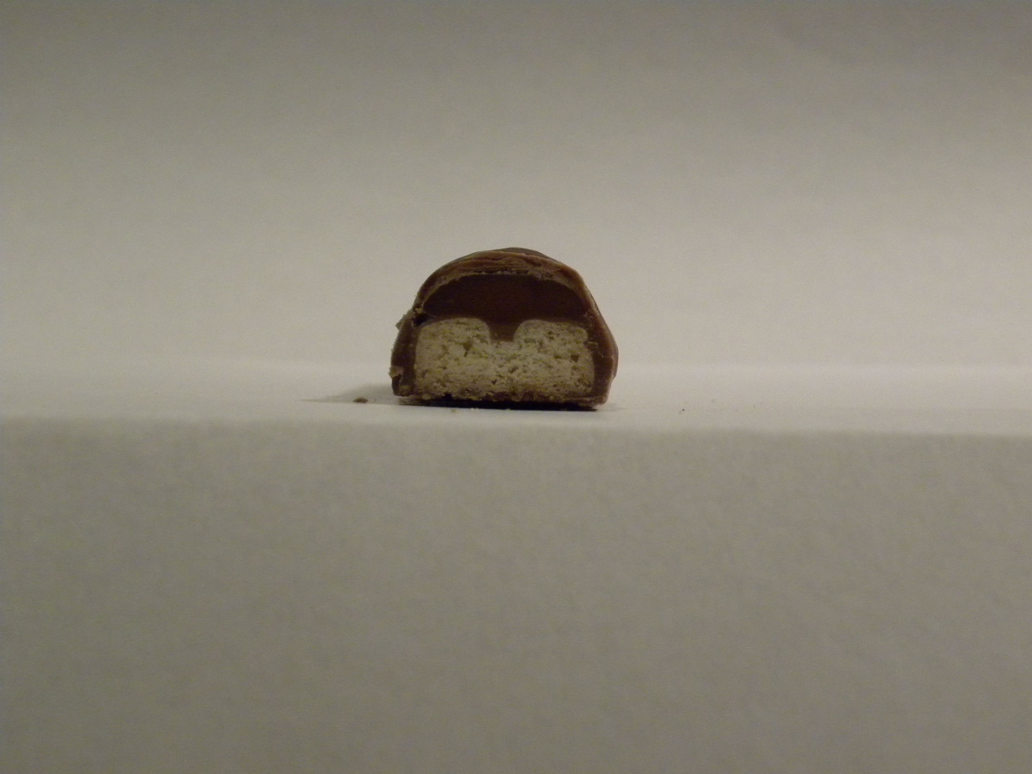
Twix

Slide 41
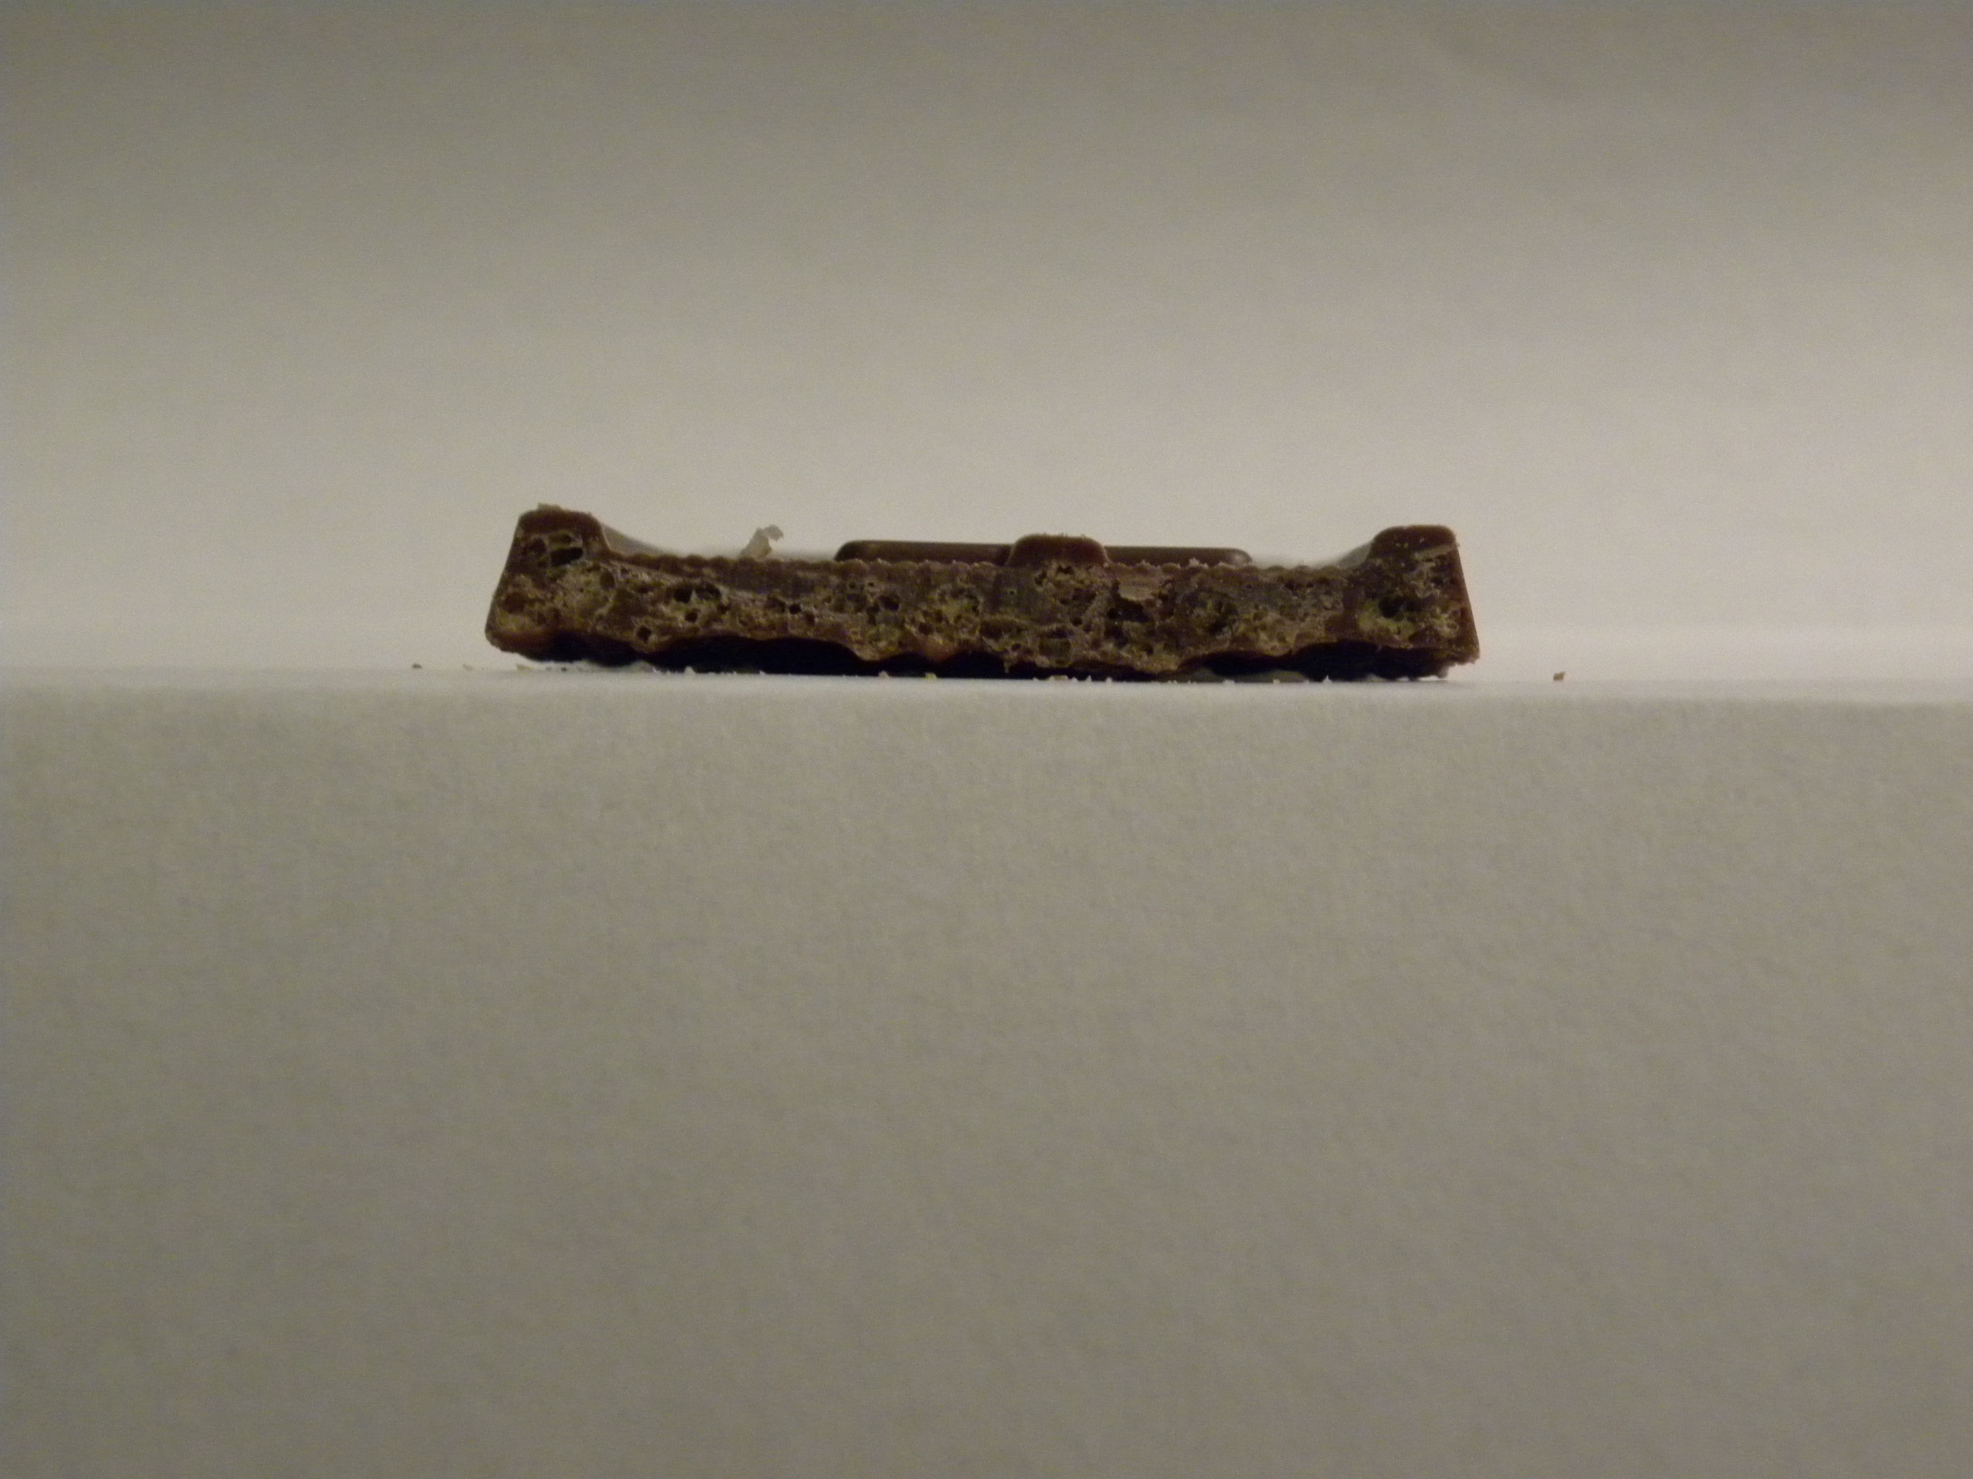
Crunch

Slide 42
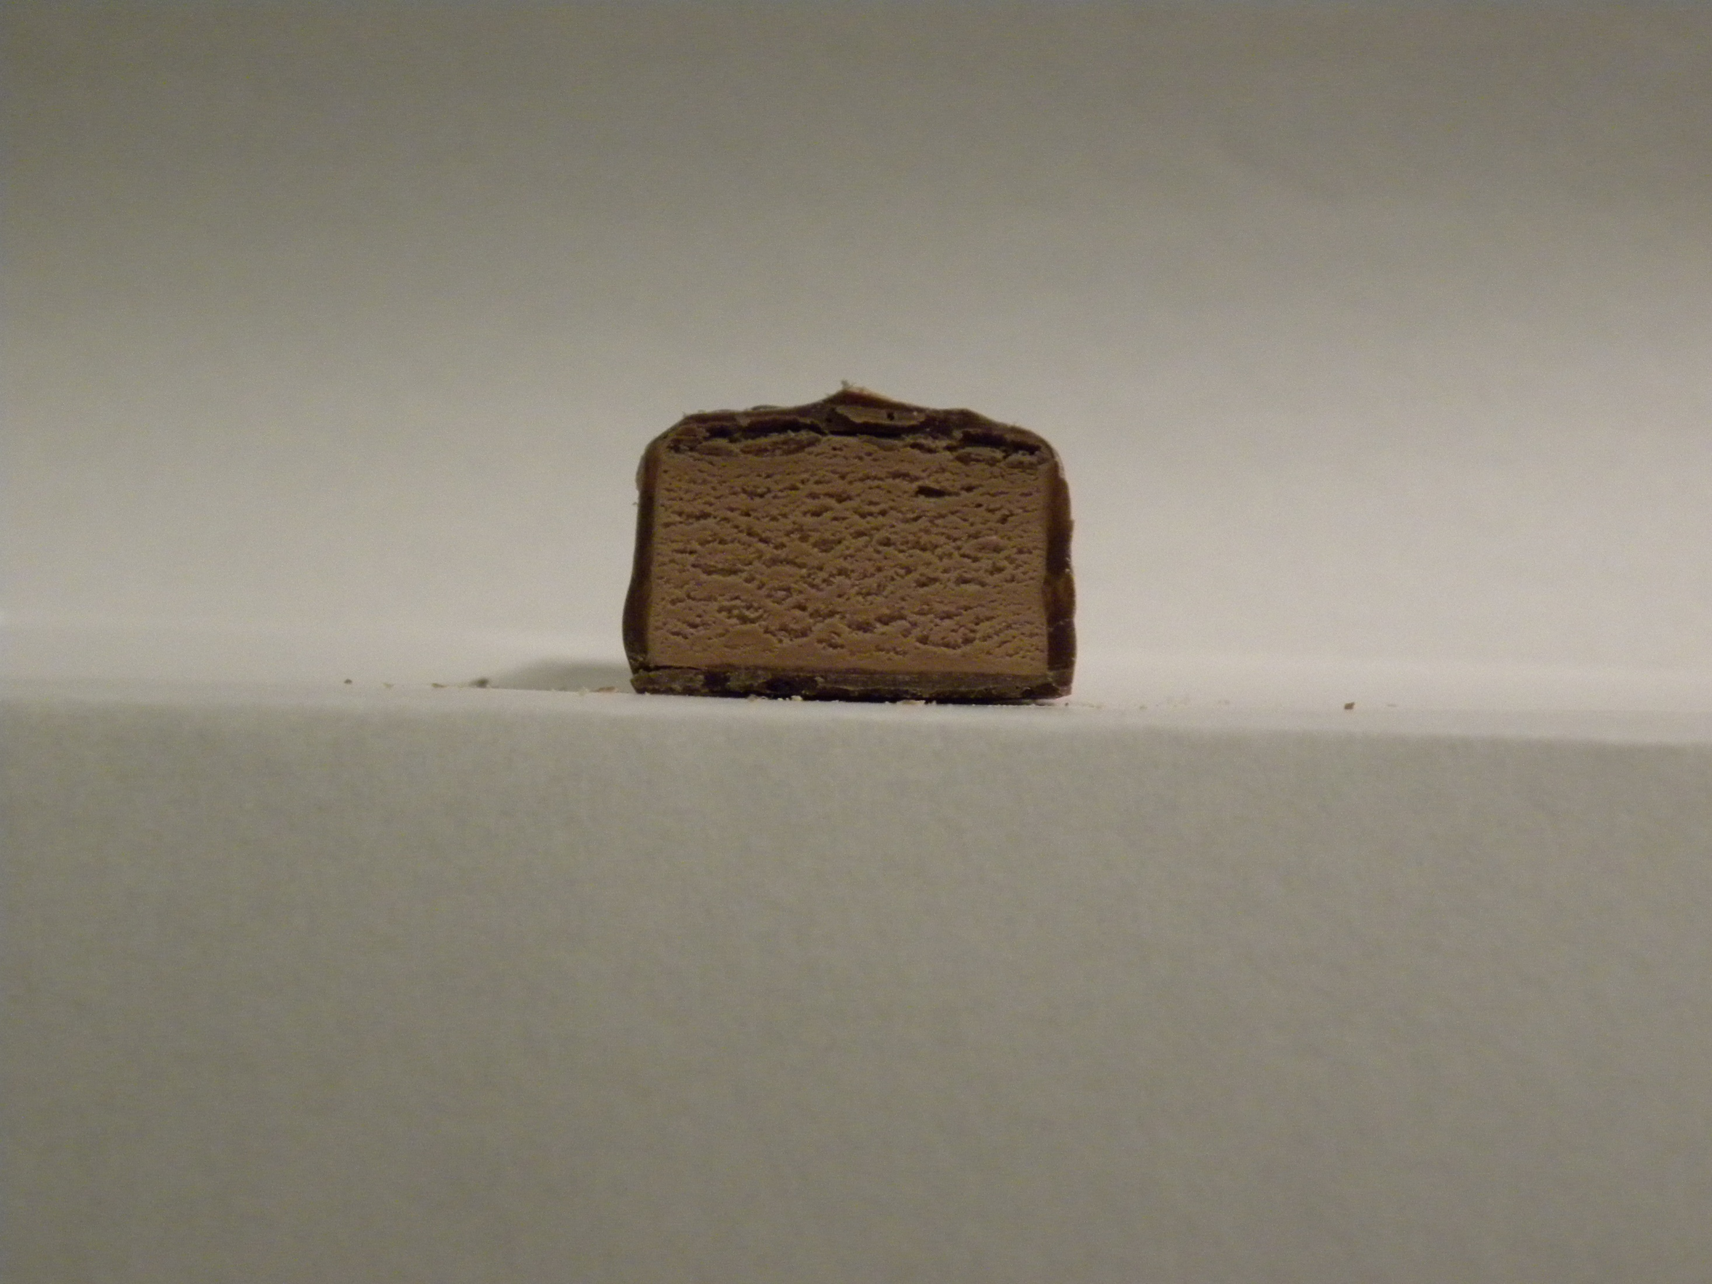
3 Musketeers

Slide 43
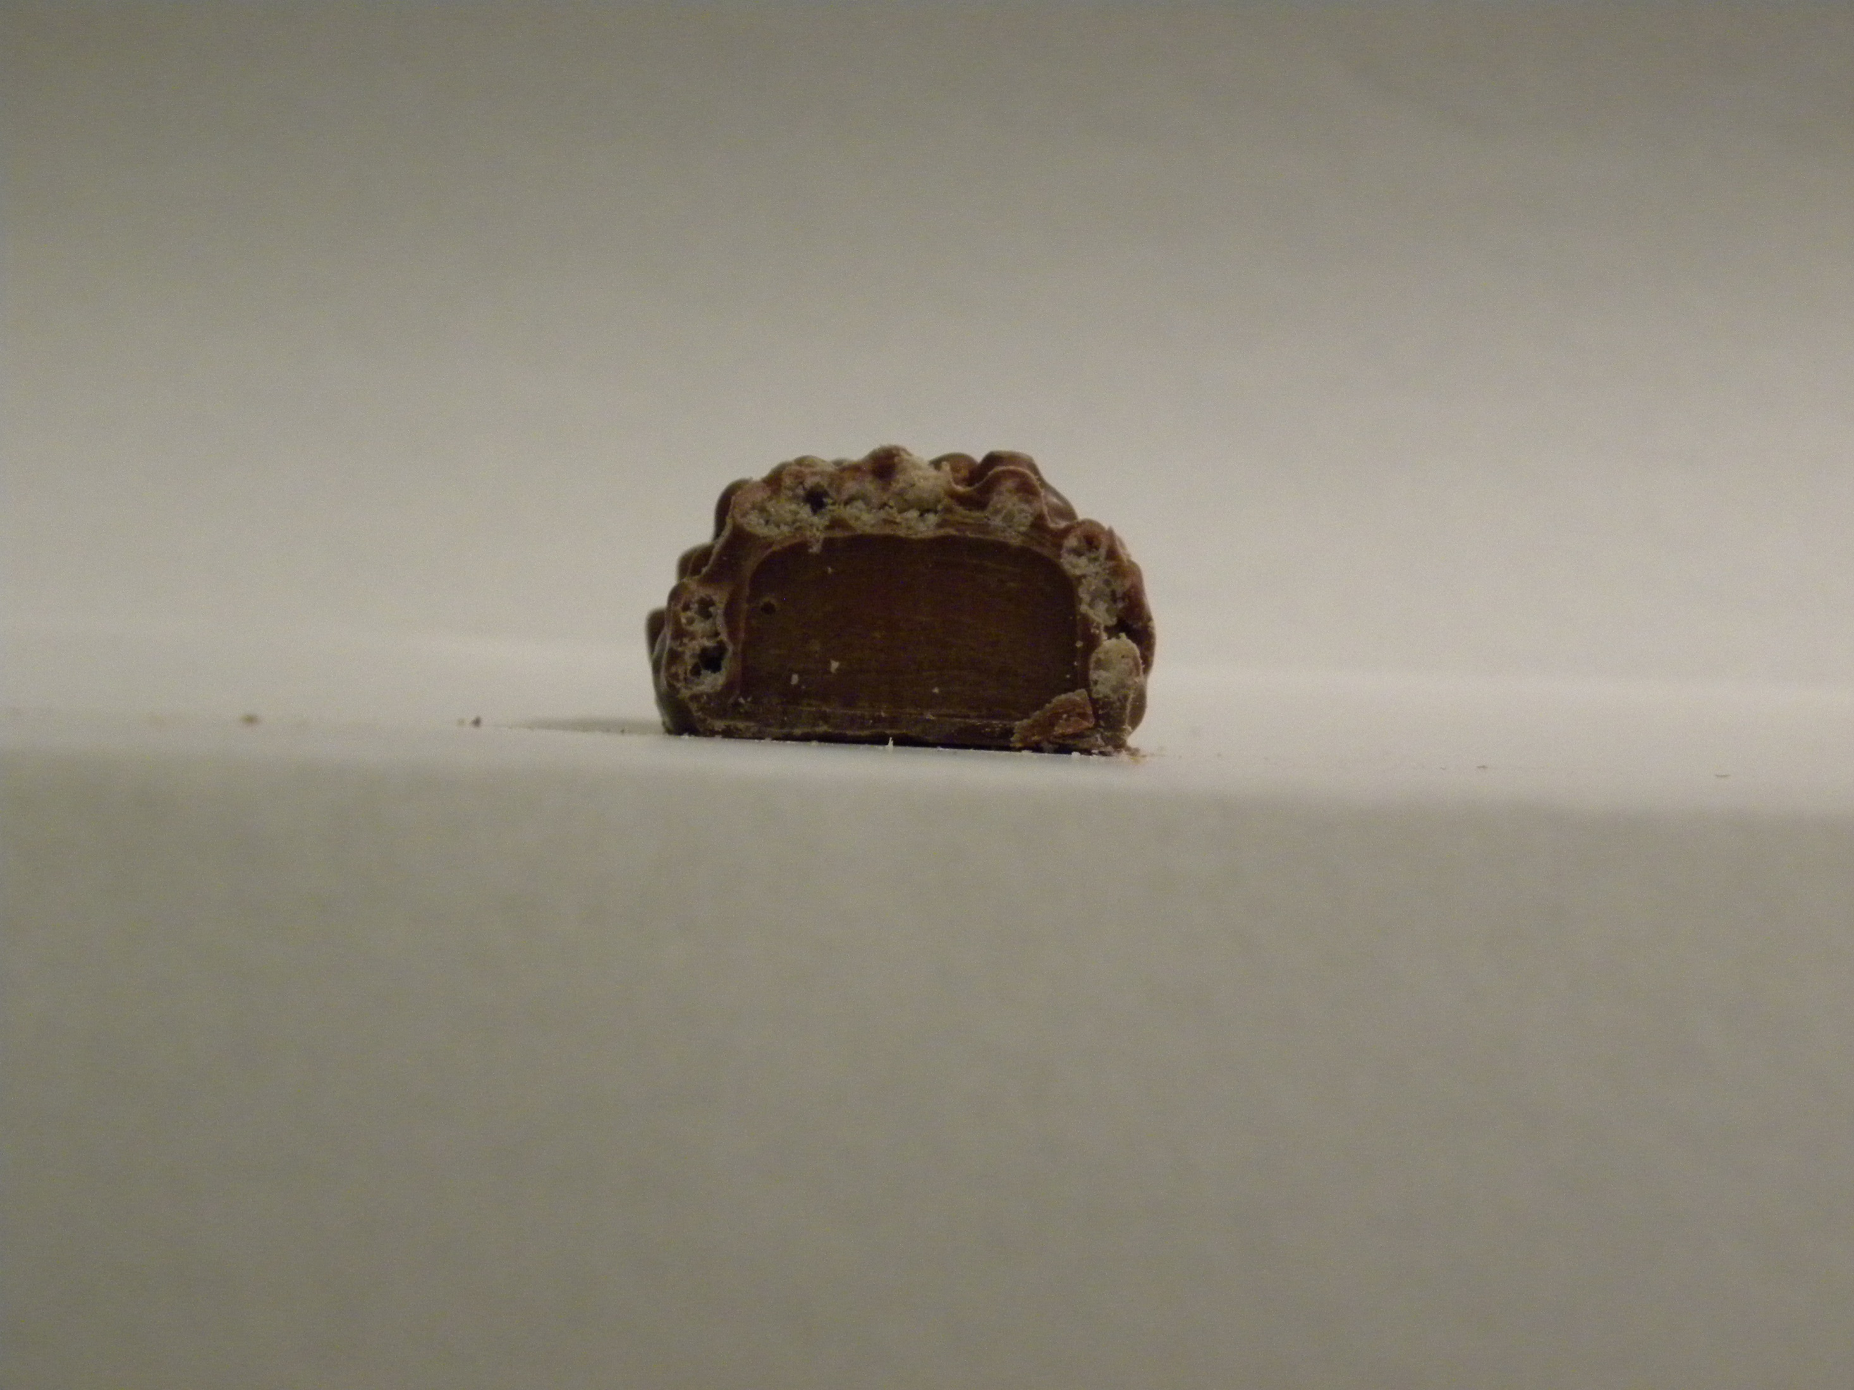
100 Grand

Slide 44
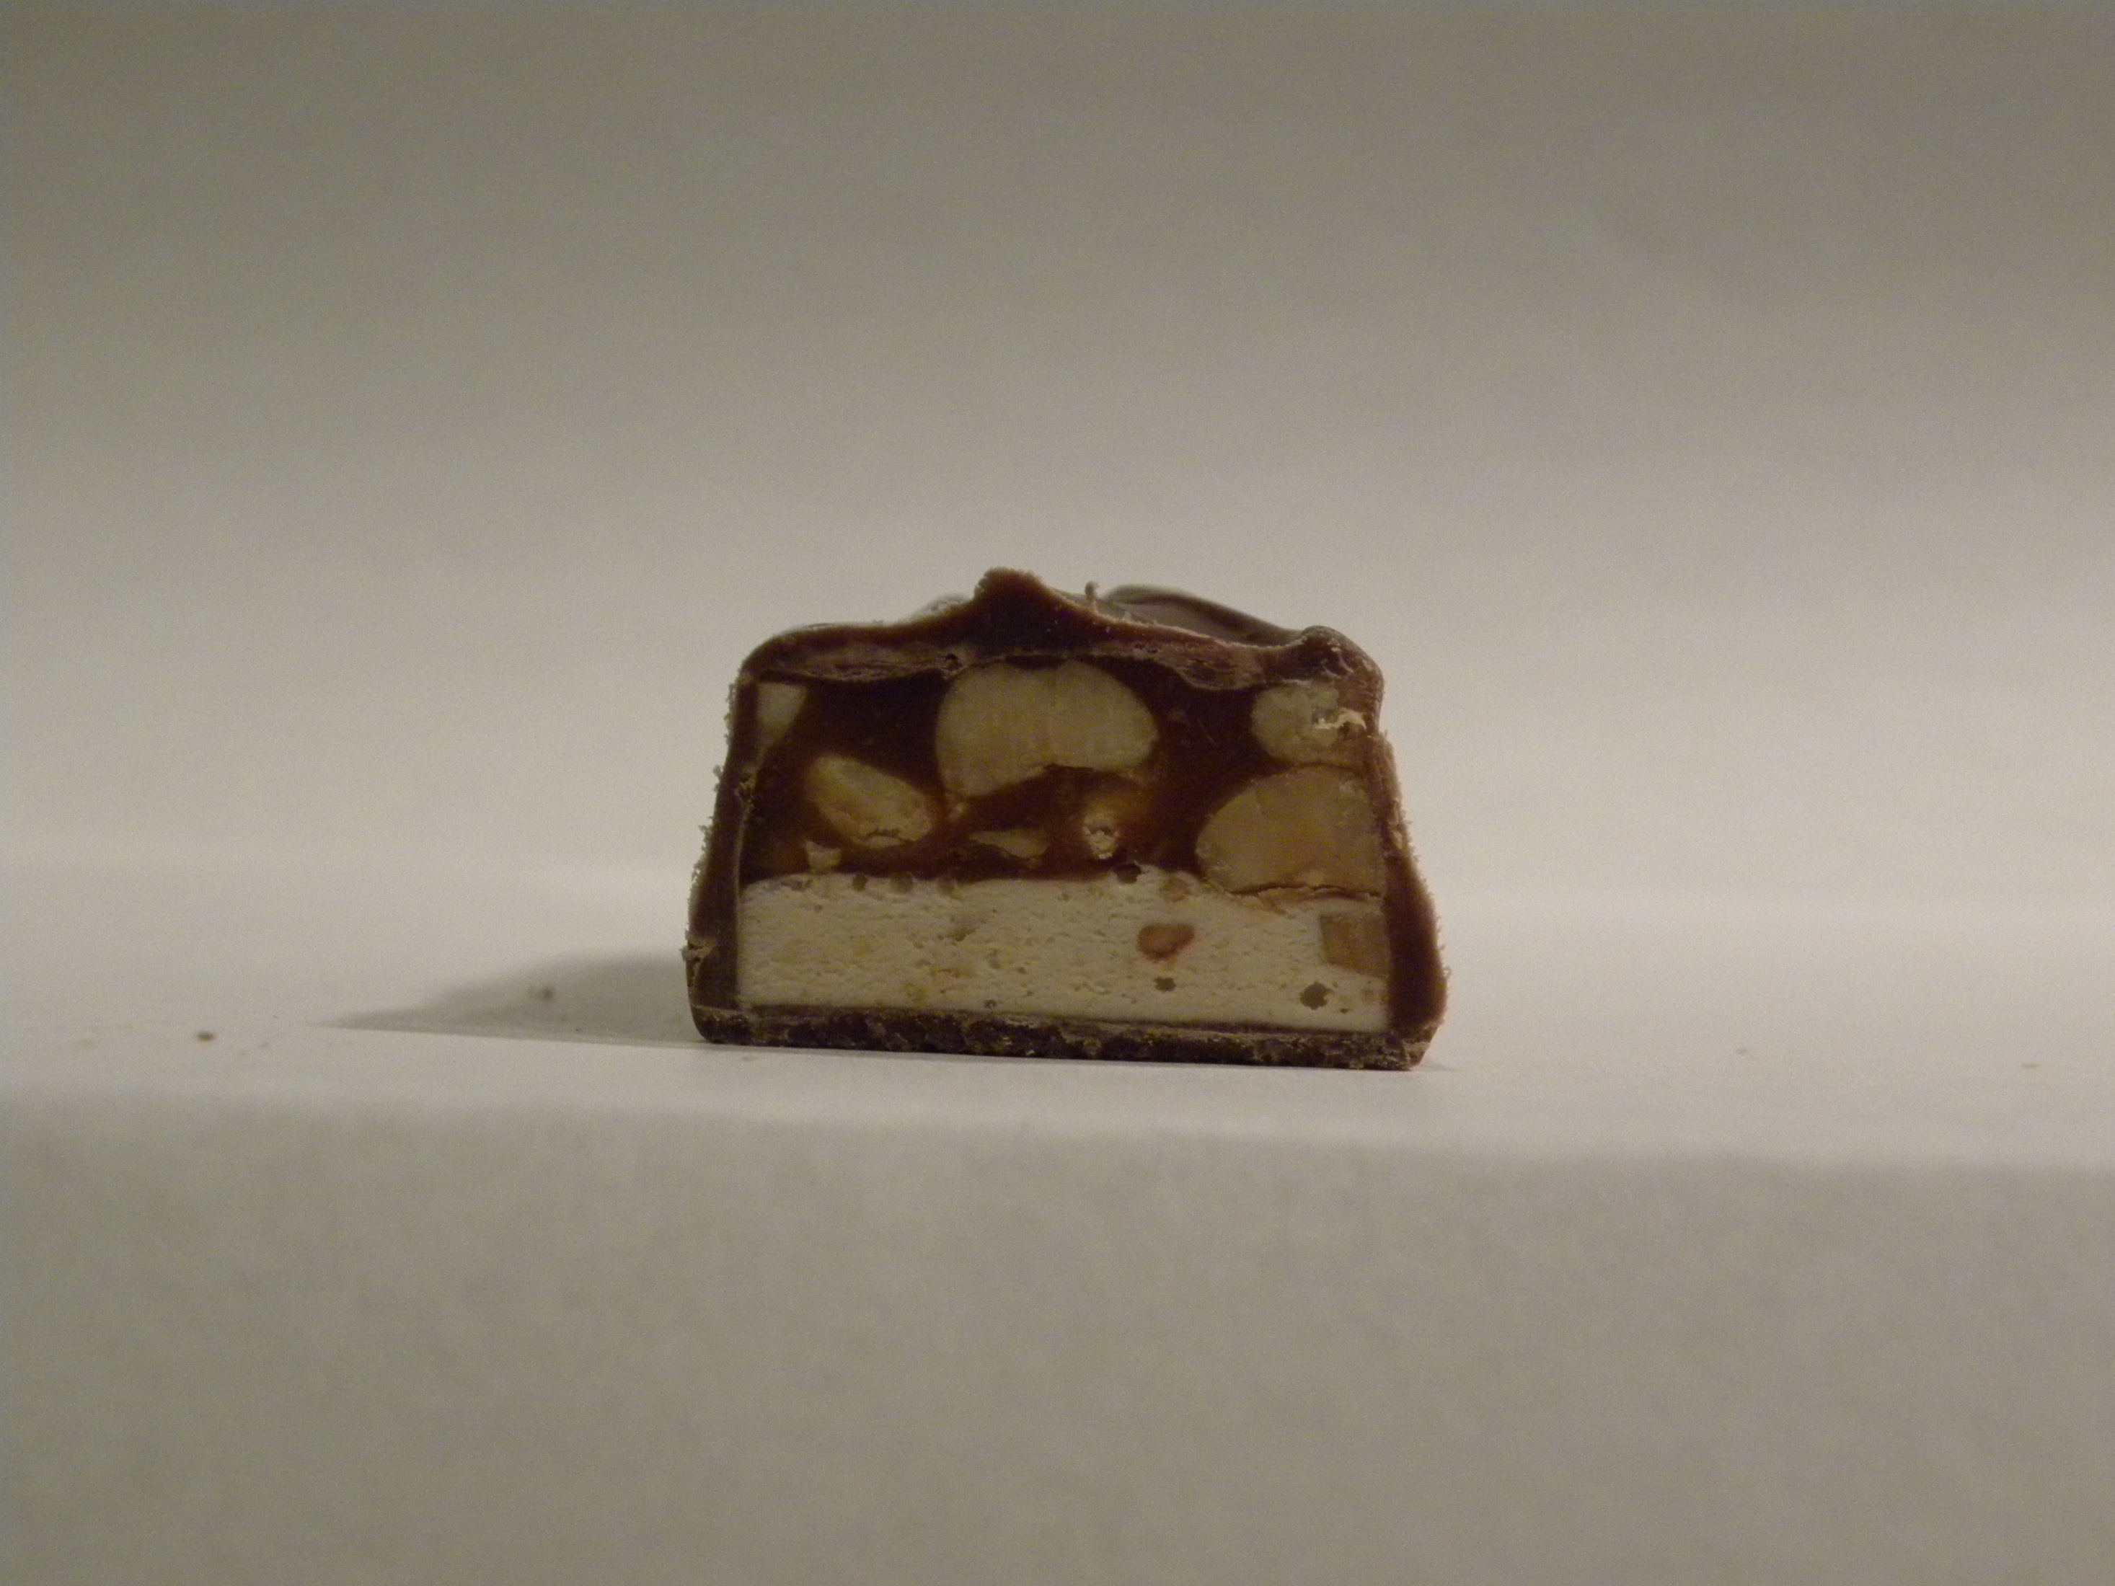
Snickers

Slide 45
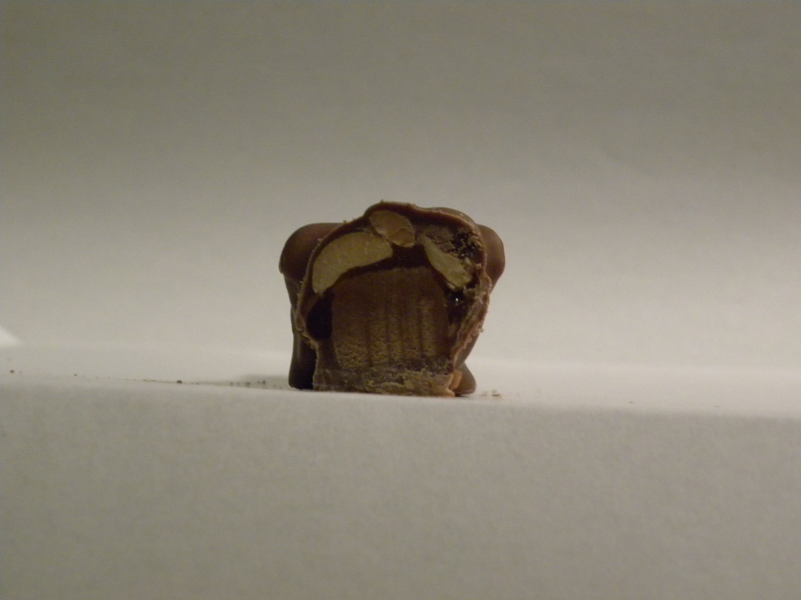
Baby Ruth

Slide 47

Game 5: Deck the halls!
Teams, choose 1 Stocking Holder.
Winning team = 5 points.

Slide 49

Game 6: Christmas carol charades
Rotate players.
1 minute turns.
6 points per correctly guessed carol.

Slide 51
Game 7: Christmas Phrase UnScramble
All players play.
7 points per correct answer.

Slide 52
dan ish mean lalsh eb dalcel frudwelno
And his name shall be called Wonderful

Slide 53
eavh fyloeurs a yrmre ettill csharmits
Have yourself a merry little Christmas

Slide 54
Ryerm ramtiscsh
Merry Christmas

Slide 55
dog sebls su yeerv noe
God bless us every one

Slide 56
Ti si eth tignh fo ruo rade sivr’oas tribh
It is the night of our dear savior’s birth

Slide 57
Dogo liwl wrotda nme
Good will toward men

Slide 58
Pyahp lahdiyso
Happy holidays

Slide 59
Nt’ow uyo dugie ym gleshi gotnith
Won’t you guide my sleigh tonight

Slide 60
Ceepa no tarhe
Peace on earth

Slide 61
ew hisw uyo a remry hamstrics
We Wish you a Merry Christmas

Slide 62
shi trahe swa otw issez oto lalms
His heart was two sizes too small

Slide 63
Sit hte nessao
Tis the season

Slide 64
hba guumhb
Bah humbug

Slide 65
Flurdo het dre-dones ridreeer
Rudolf the Red-Nosed Reindeer

Slide 66
Swat het gihnt feebor sictmarhs
Twas The night Before Christmas

Slide 67
zelfi vaadind
Feliz navidad

Slide 68
Llo’yu otosh uory yee uto
You’ll shoot your eye out

Slide 69
slithg ta tmeepl queras
Lights at temple square

Slide 71

Game 8: Stocking Stuffers
Teams, choose 1 Stocking Holder.
Timer: 2 minutes.
8 points per every candy more than the losing team.

Slide 73
Game 9: Christmas Timeline
Teams, collect an envelope. Do not open until instructed.
Timer: 1 minute.
9 points for the team who completes their timeline first…
Or .5 points per correctly-located item.

Slide 74
The Correct Timeline Is:
It’s a Wonderful Life – 1946
Miracle on 34th Street – 1947
Rudolph the Red-Nosed Reindeer – 1964
How the Grinch Stole Christmas – 1966
Mr. Krueger’s Christmas – 1980
A Christmas Story – 1983
Home Alone – 1990
The Santa Claus – 1994
Elf – 2003
The Polar Express - 2004

Slide 76

Game 10: Crack the Carol code
Teams, collect your worksheet and a pencil. Do not look until instructed to do so.
Timer: 3 minutes.
10 points per correctly decoded clue.

Slide 77
Correct Answers:
White Christmas
Chestnuts Roasting on an Open Fire
All I Want for Christmas is My Two Front Teeth
Oh Holy Night
It Came Upon a Midnight Clear
Oh Come All Ye Faithful
Away in a Manger
Deck the Halls
Little Drummer Boy
We Three Kings
Silent Night
God Rest Ye Merry Gentlemen
Santa Claus is Coming to Town
Let it Snow
Go Tell it on a Mountain
Rudolph the Red-Nosed Reindeer
What Child is This
Joy to the World
Hark! The Herald Angels Sing
The Twelve Days of Christmas

Slide 79
Game 11: Defend Christmas!
Teams, choose 1 Builder. Builder, collect your tools. One has a star: it must go on top.
All other players, collect your weapons.
First team to complete their Christmas tower = 11 points.

Slide 81
Thanks for playing Christmas Game night!
Tally up your points to see who wins

